Slide 1
Roles & Responsibilities for UV2026 Session Chairs

Slide 2
Timetable for Session Chairs
Date | Responsibilities / Tasks
August 1 | Finalize speaker and panelist profiles, including bios, affiliations, profile photos, talk titles, and abstracts.
September 1 | Conclude the peer-review process for manuscripts submitted by the official August 1 deadline. Issue official acceptance notifications to authors.
September 5 | Submit proposed session agendas to the Program Chairs, including preferred scheduling, speaker order, presentation durations, and total session length.
September 15 | Conclude the review process for Program Chair-approved late submissions, if applicable. (Round 1) Review final program arrangements and update session agendas, speaker titles, and abstracts.
September 30 | Complete any remaining review updates for approved late submissions, if applicable. (Round 2) Review and update the official Conference Program Book materials.
October 7 | Finalize remaining session updates and submit session documentation to the Program Chairs. (Round 3) Compile and submit session proceedings materials, subject to Program Chairs’ confirmation.
October 10–11 | Conduct technical connectivity tests with session speakers and collect backup presentation videos.
October 17–20 | [IEEE UV2026 Conference] Execute the live session, manage Q&A, and ensure adherence to the published schedule.
November 1 | Collect post-event revised files and final archive materials from invited speakers and general authors, if required.
November 8 | Submit updated session documentation and folders to the Program Chairs. Provide any necessary technical clarifications for the final archive.

Slide 3
Timetable for Program Chairs
Date | Responsibilities / Tasks
August 1 | Review and approve the roster of invited speakers to ensure technical alignment with UV2026 themes.
September 1 | Distribute technical instructions for preparing camera-ready manuscripts. Issue formal registration reminders to all prospective attendees and authors.
September 5 | Collect and synthesize session program proposals from Session Chairs to begin building the master schedule.
September 15 | Consolidate session program updates and synthesize the master agenda. Finalize scheduling and time slots with all Session Chairs.
September 25 | Commence formal compilation of the official Conference Program Book.
October 1 | Update and digitally publish the Conference Program Book on the official website. Compile online meeting instructions and notify all presenters and attendees.
October 10 | Update the Conference Program Book on the official website. Compile preliminary Conference Proceedings and generate secure download access for registered participants.
October 10–11 | Conduct technical connectivity tests with keynote speakers and collect backup video presentations.
October 17–20 | [IEEE UV2026 Conference] Coordinate the Sessions, Keynote Day, and Closing Ceremony of IEEE UV2026.
November 1 | Review and verify collected session manuscripts for IEEE formatting and copyright compliance.
November 30 | Incorporate post-event updates into the definitive Program Book and Conference Proceedings. Submit the final proceedings package to IEEE for possible archival and inclusion in IEEE Xplore, subject to IEEE scope, formatting, copyright, and quality requirements.

Slide 4
Roles & Responsibilities of Session Chairs 【1】Session Organization
Prepare and distribute the session-specific “Call for Papers” poster. *
Prepare and distribute the “Session Committee & Invited Speakers” poster. *
Invite authors, session committee members, speakers, and reviewers.
Collect and submit speaker bios, profile photos, talk titles, and abstracts to the Program Chairs.
Ensure that authors follow IEEE paper formatting and copyright requirements for camera-ready papers. *
Organize paper reviews through the online review system. *
Submit the proposed session program and agenda to the Program Chairs.
Remind speakers and authors to register early to receive the early-bird rate.
* [To be completed together with Session Assistants]

Slide 5
Roles & Responsibilities of Session Chairs – 【2】 Online/Hybrid Session Preparation
Keep Program Chairs updated on session progress and any program changes.
Notify speakers about their assigned time slots and confirm their availability. *
Ensure stable connections for remote presenters and stable performance of on-site audio/video systems. *
Collect backup presentation videos, in case a presenter does not show up, record the no-show in the Session Report Form and do not move to the next scheduled presentation. *
Prepare roundtable discussion topics. *
* [To be completed together with Session Assistants]

Slide 6
Roles & Responsibilities of Session Chairs
【3】 Hosting Online/Onsite Session Presentation
Announce the beginning of session presentation and introduce the session topics.
Present a brief summary of the session.
Introduce each speaker and presentation title.
Host each presentation.
If a presenter does not show up, play backup video and do not move to the next scheduled presentation.
Maintain the pre-announced presentation schedule.
Host the Q&A discussion.
Provide session closing remarks to thank speakers and attendees.
Present session highlight on the UV2026 closing remarks on Oct.20.
Submit the session report to program chair.

Slide 7
Roles & Responsibilities for UV2026 Session Assistants

Slide 8
Roles & Responsibilities of Session Assistants
【1】Session Organization
Design and update session posters using the UV2026 poster template.
Update session posters with bios and profile photos of session committee members and invited speakers.
Monitor paper submission status and report updates to Session Chairs.
Report duplicate submissions and technical issues to the IT Team and Program Committee.
Provide technical support for the online review system for Session Chairs and reviewers.
Assist authors in preparing camera-ready papers that meet IEEE formatting and copyright requirements.
Assist with UV2026 registration and payment questions for session speakers, and presenters, when needed.
Collect backup presentation videos and related session materials.

Slide 9
Roles & Responsibilities of Session Assistants
【2】 Assistant for Session Preparation
Assist Session Chairs in notifying speakers about assigned time slots and confirming availability.
Test and support stable connections for remote presenters and stable performance of on-site audio/video systems.
Collect speakers’ materials for Session Chairs in presentation order, including bios, profile photos, presentation files, and backup videos.
Provide technical support to Session Chairs and speakers before and during the session.
Keep backup files organized and accessible in case of technical issues during the live session.

Slide 10
Roles & Responsibilities of Session Assistants
【3】 Assist for Hosting Session Presentation
Assist Session Chair in starting the session on time.
Monitor the online/onsite meeting room and provide real-time technical support.
Help speakers manage slides, screen sharing, audio, video, and backup files.
Track session timing and remind Session Chair when needed.
Assist with no-show situations and play backup video.
Monitor audience questions and support Q&A management.
Record attendance, no-shows, technical issues, and key session notes.
Help Session Chairs close the session and organize post-session materials.

Slide 11
Roles & Responsibilities of Session Assistants
【4】 Responsibilities After the Session Closing
Collect and Organize final presentation files, backup videos, session presentation videos and session materials.
Assist Session Chair in completing the Session Report.
Follow up with authors or speakers to obtain final manuscripts meeting all of requirements.
Check whether all final manuscripts meet IEEE formatting, copyright, and camera-ready requirements.
Ensure that authors respond to reviewers’ comments, make required revisions, and submit corrected manuscripts before the final deadline.
Organize accepted papers and session documents into final proceedings package.
Submit finalized session materials to Publication Chairs.
Maintain a clear archive for post-conference records and proceedings preparation.

Slide 12
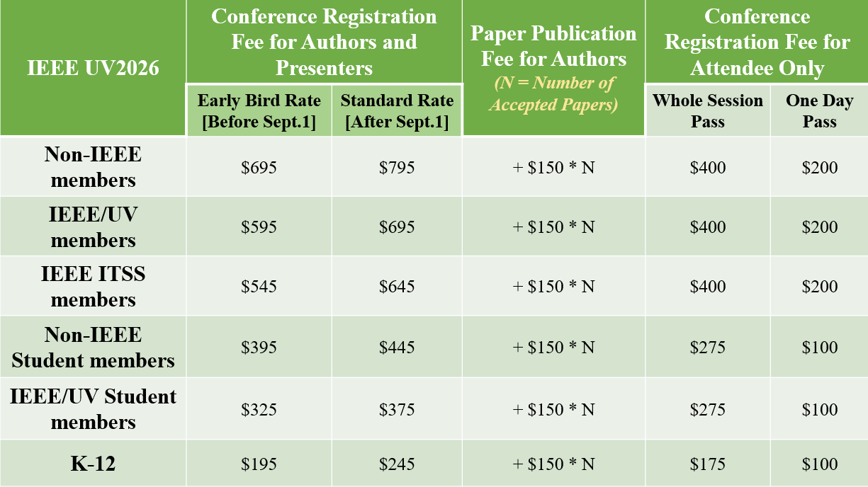
Registration Fee
*All fees are in USD and subject to confirmation on the official UV2026 registration page.

Slide 13

Thank You!
Let’s Work Together to Make IEEE UV2026
Successful!
Another UV Milestone!

